Slide 1
Listing Manager
Stratus-to-Matrix
Train-the-Trainer
Notes:
Welcome to your new OneKey MLS experience! As you get started we want to make sure you are prepped and ready to hit the ground running the day you cutover fully to using your new central dashboard provided by Clareity, Matrix, Realist, OneHome and an enhanced MLS-Touch. With that in mind, we’ve divided your onboarding into 3 phases, with clear actions and information for each step of your progression:

Slide 2
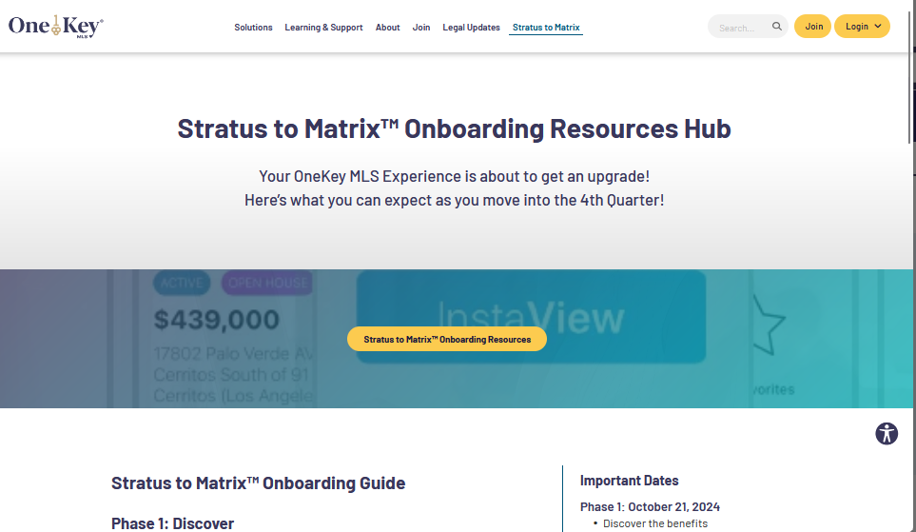
Your listings from Stratus will be available in Matrix!

Slide 3
Reminders
Valid Listing Agreement
Be Sure Enter Listings in a Timely Manner – 24 hours
Listing Status Changes – 24 hours
For Active and Coming Soon Listings – 1 Photo
No mention of compensation anywhere
No branding in the public remarks

Slide 4
Agenda
Adding a New Listing
Editor – Listing Fields
Adding Photos
Add/Edit Broker Functions
Editing an Existing Listing
Saving a listing

Slide 5
Add/Edit

Slide 6
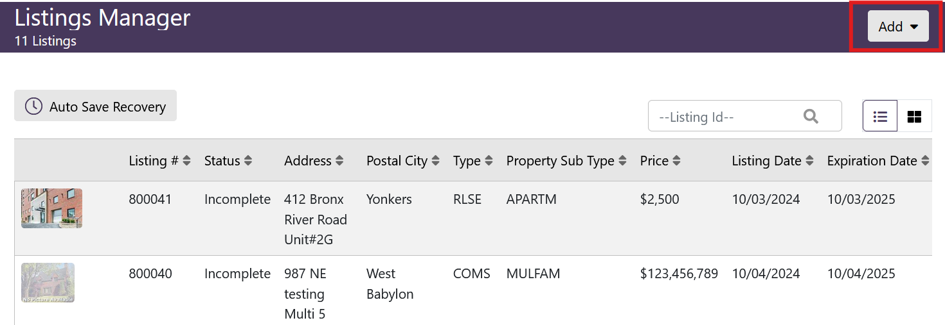
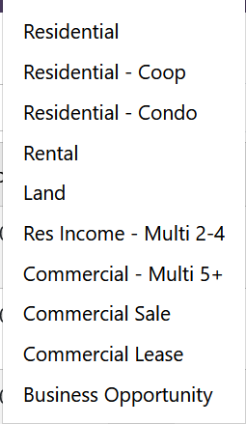
Listing Manager

Slide 7
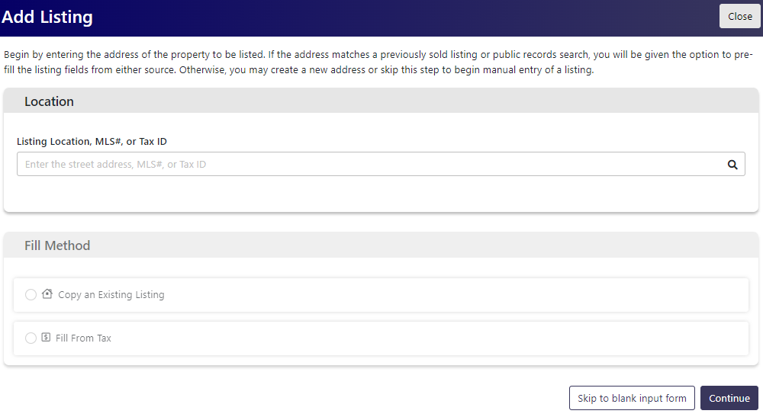
Location

Slide 8
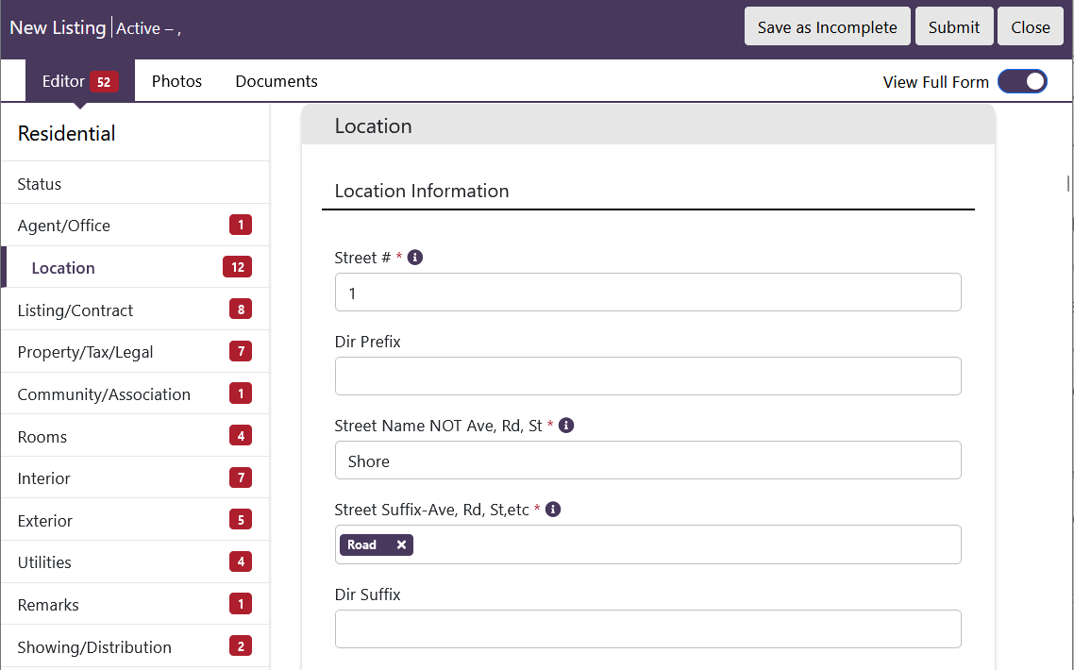
Editor

Slide 9
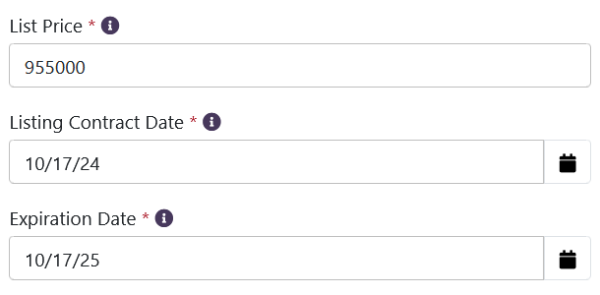
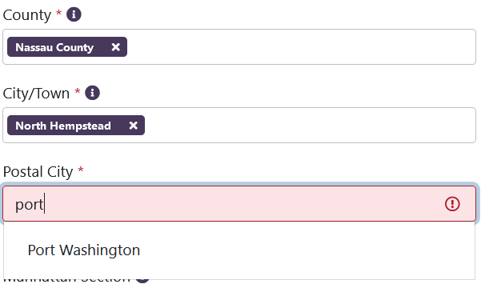
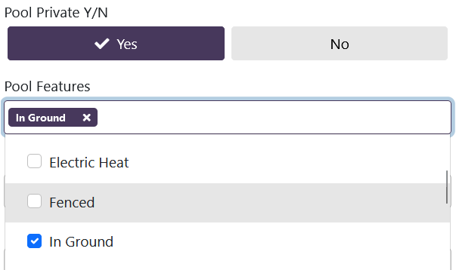
Editor Fields

Slide 10
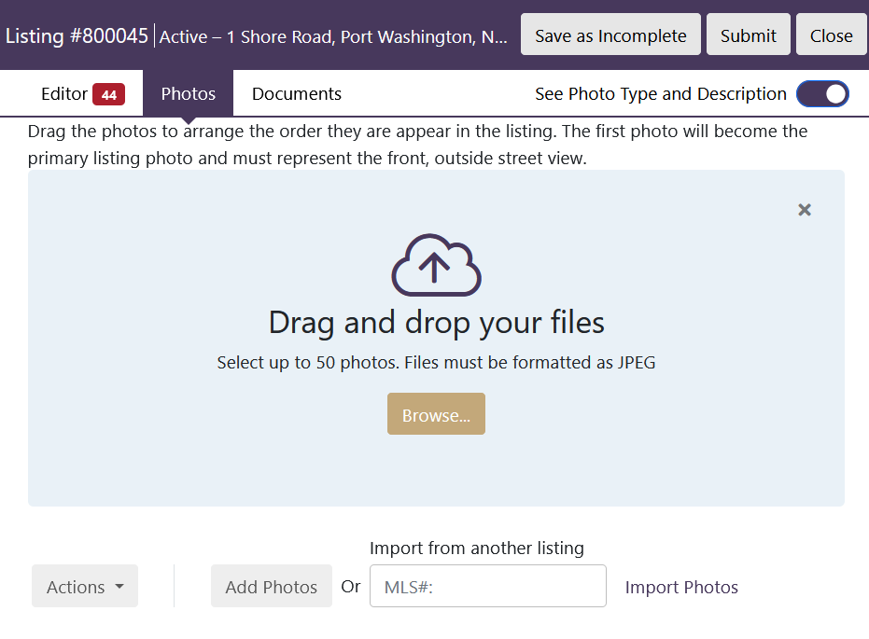
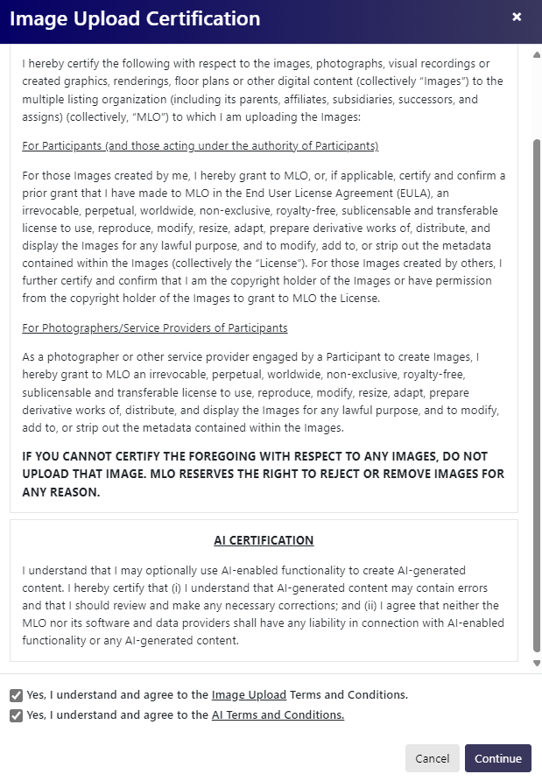
Photos

Slide 11
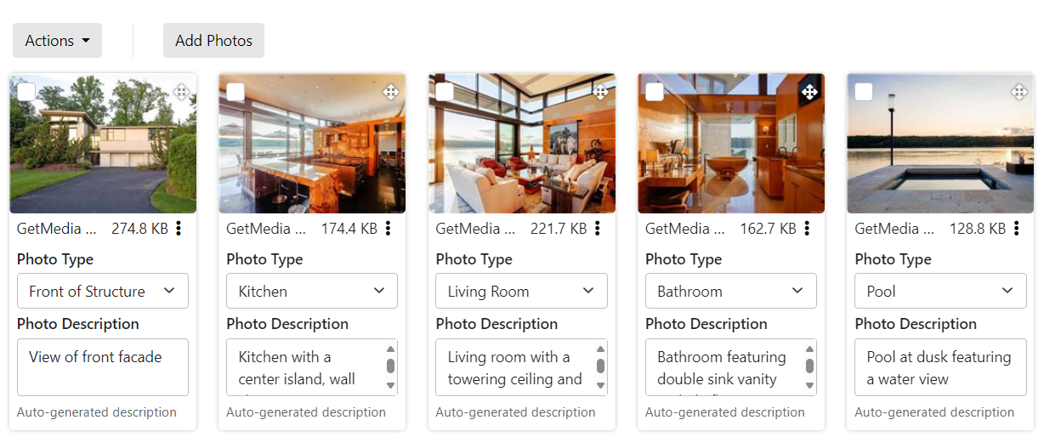
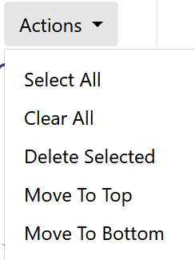
Photo Captions & Descriptions

Slide 12
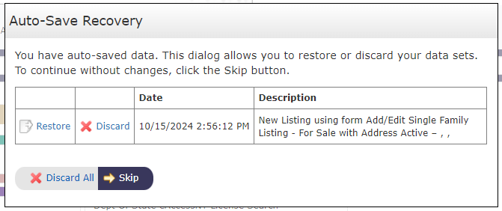
Save and Submit

Slide 13
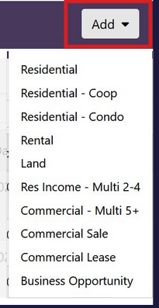
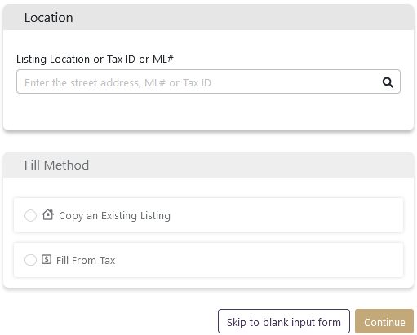
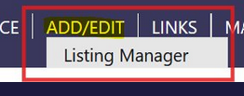
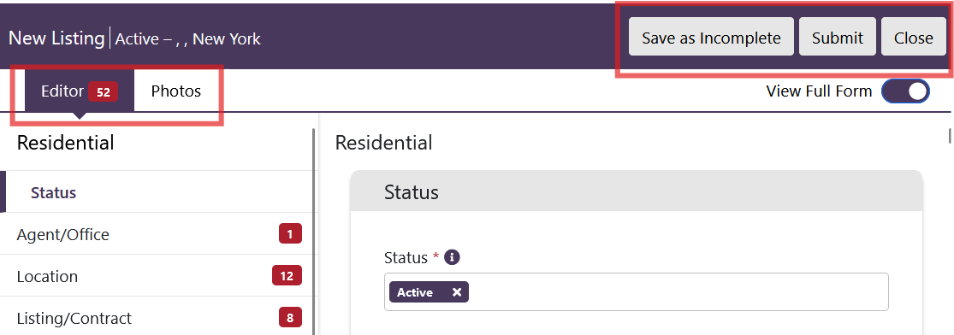
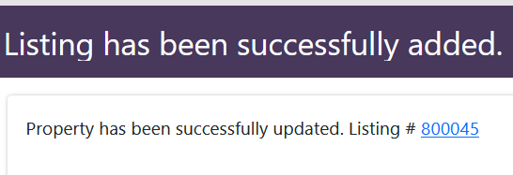
Overview - Adding a New Listing

Slide 14
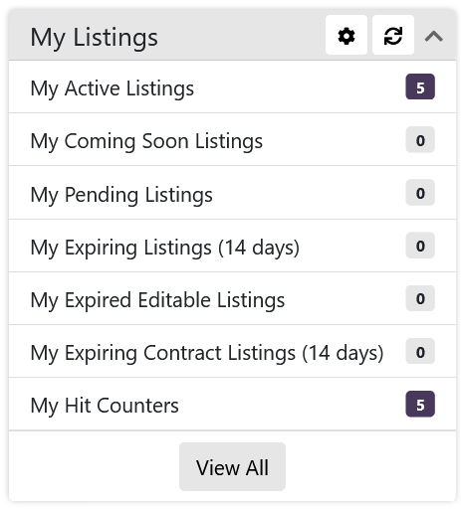
Edit Listing

Slide 15
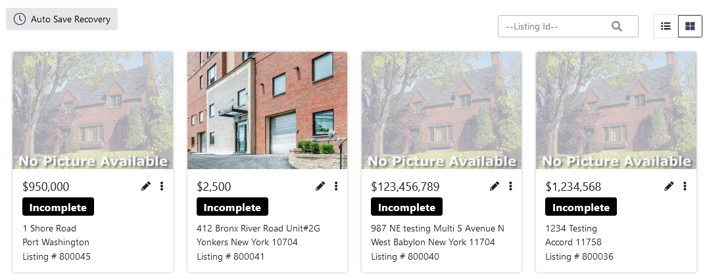
Listing Manager

Slide 16
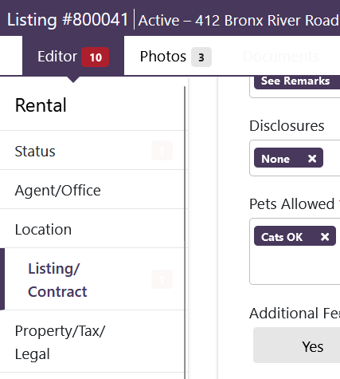
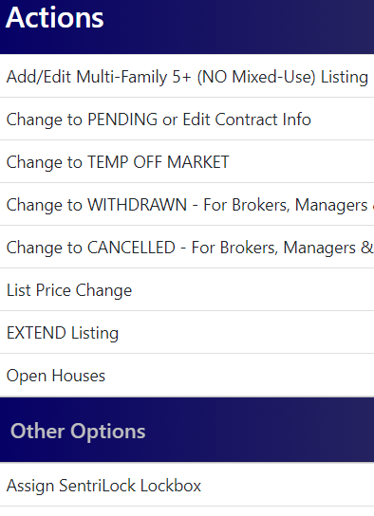
Editing/Updating Listings
Edit
...
Actions

Slide 17
Broker/Admin Options

Slide 18
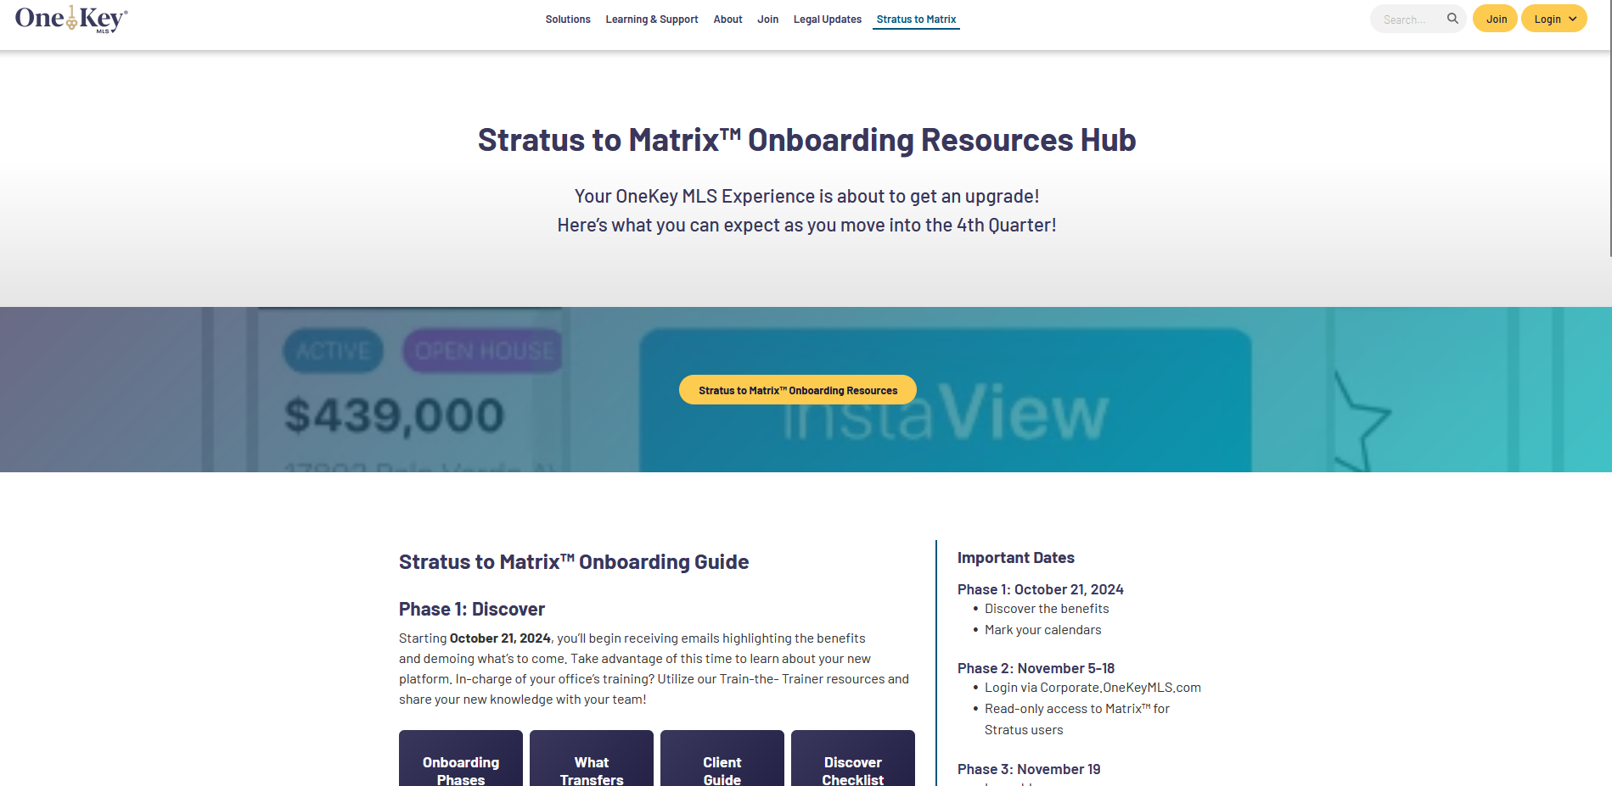
RESOURCES
Dec 3rd – Cut Over: Matrix Listing Manager Available
Corporate.OneKeyMLS.com/Stratus-to-Matrix

Slide 19
Prepare
Questions?

