Slide 1
Client Collaboration
Stratus to Matrix Onboarding
Notes:
Welcome to your new OneKey MLS experience! As you get started we want to make sure you are prepped and ready to hit the ground running the day you cutover fully to using your new central dashboard provided by Clareity, Matrix, Realist, OneHome and an enhanced MLS-Touch. With that in mind, we’ve divided your onboarding into 3 phases, with clear actions and information for each step of your progression:

Slide 2
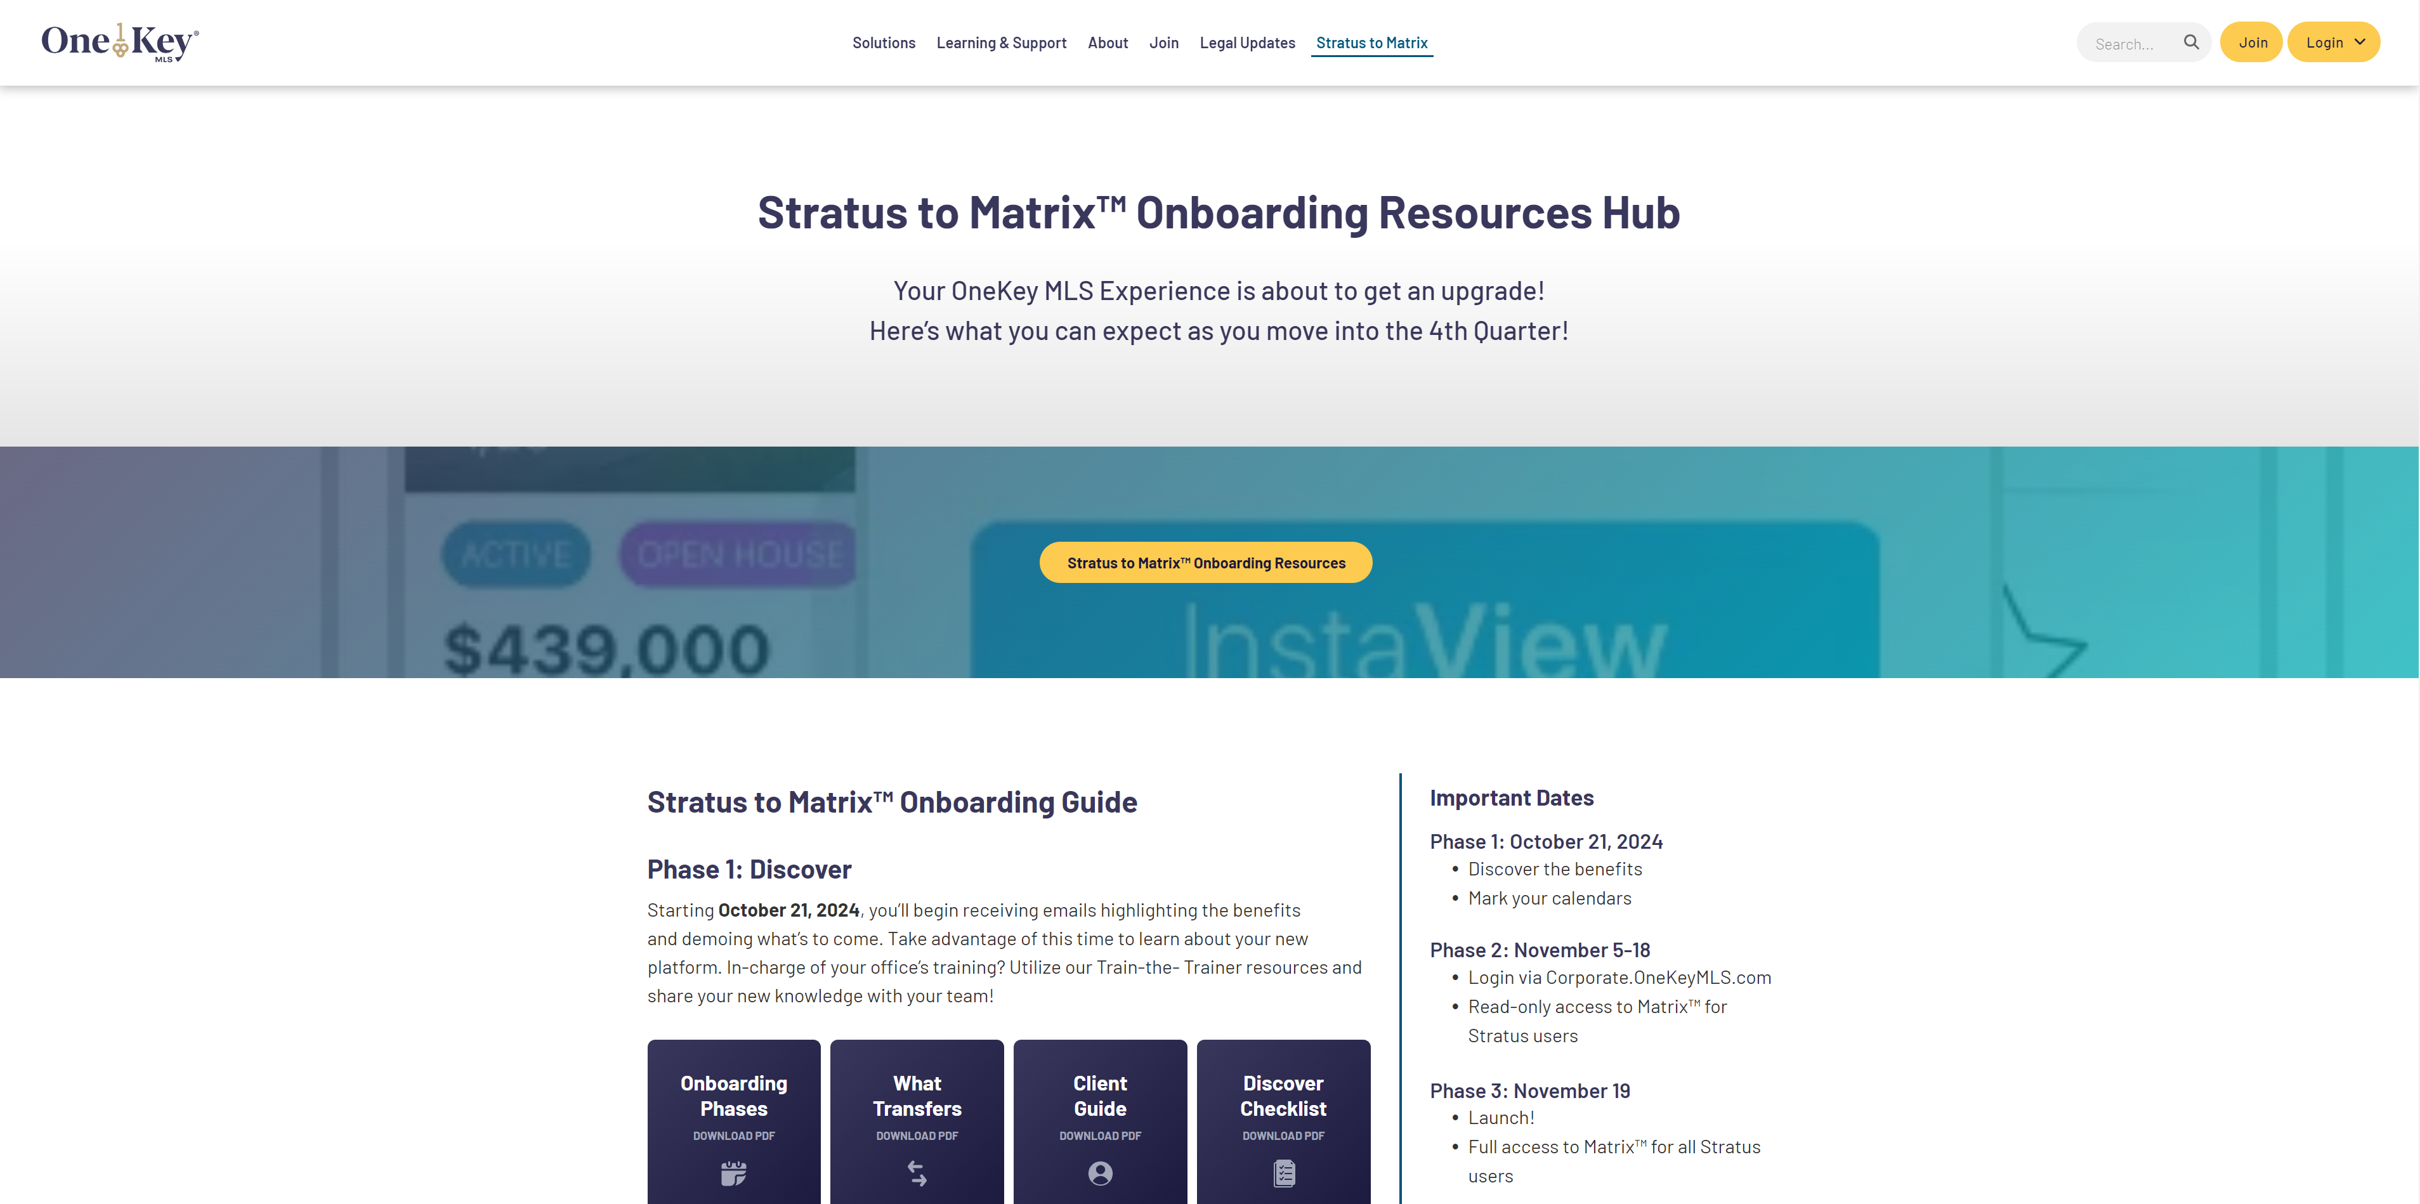
Corporate.OneKeyMLS.com/Stratus-to-Matrix

Slide 3
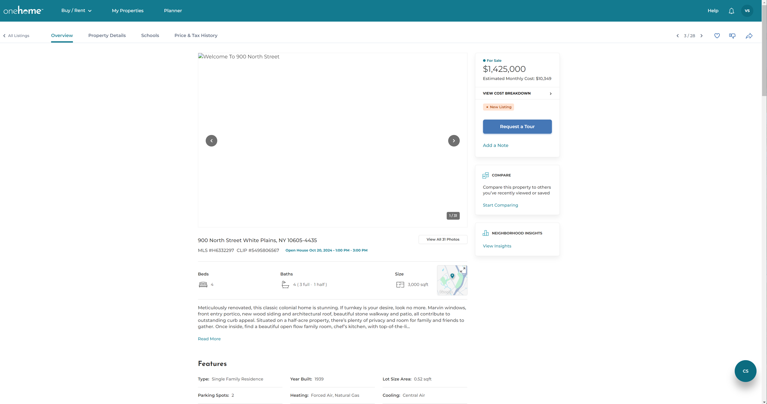
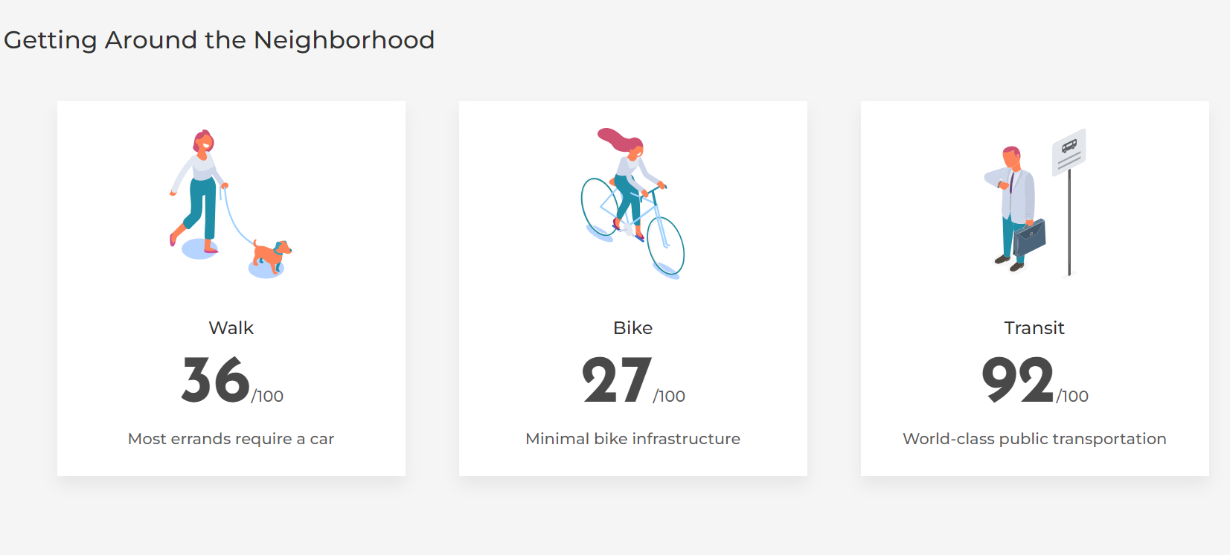
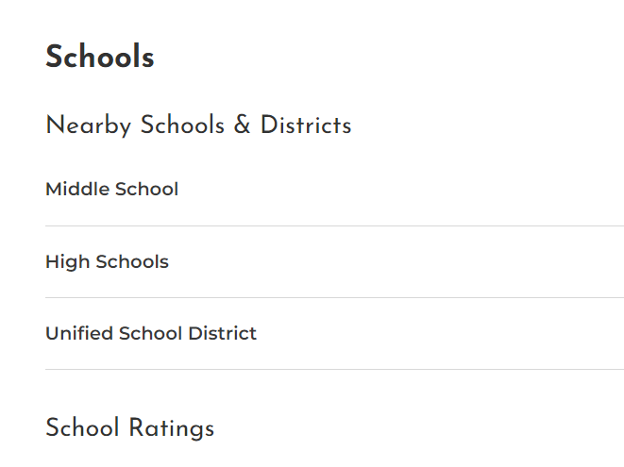
What is OneHome?
Prepare
Nov 5-18

Slide 4
Agenda
Branding
Notifications
Saved Search to Auto Email
Client Experience
Agent Experience

Slide 5
Branding
Agent Photo, Office Logo, and Account Information transfer automatically.

Slide 6
Branding
Agent Photo, Office Logo, and Account Information transfer automatically.

Slide 7
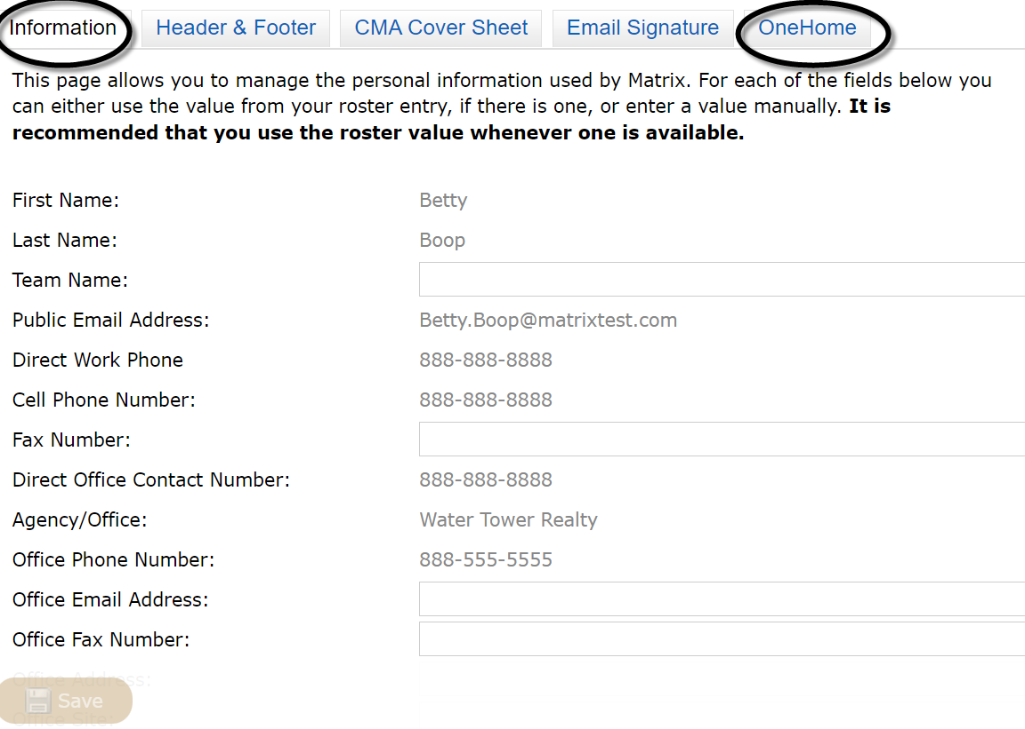
Branding

Slide 8
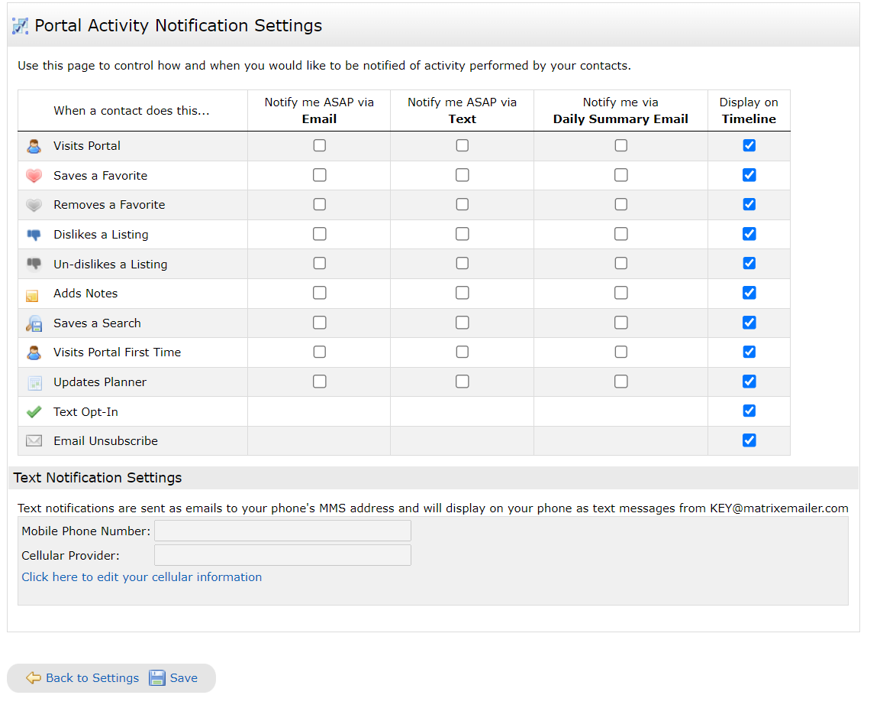
Notifications

Slide 9
Saved Search to Auto Email

Slide 10
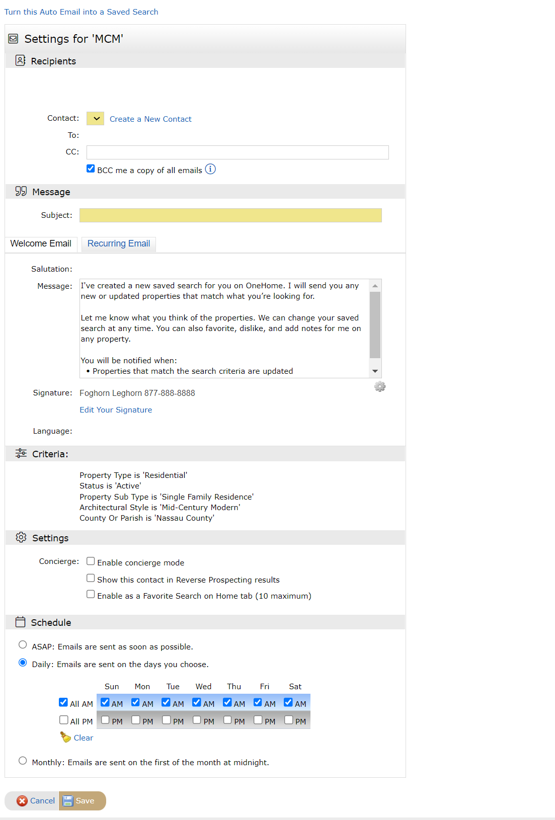
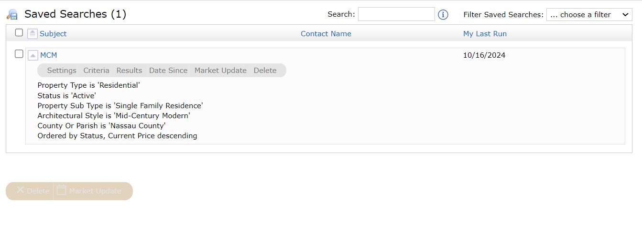
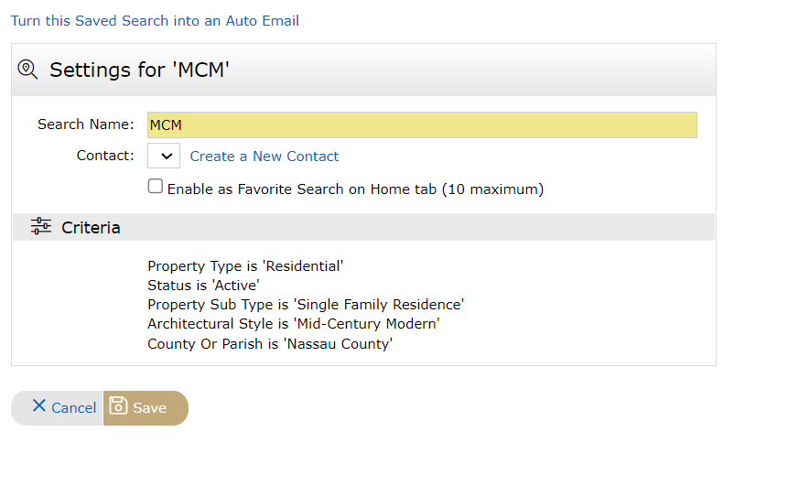
Saved Search to Auto Email

Slide 11
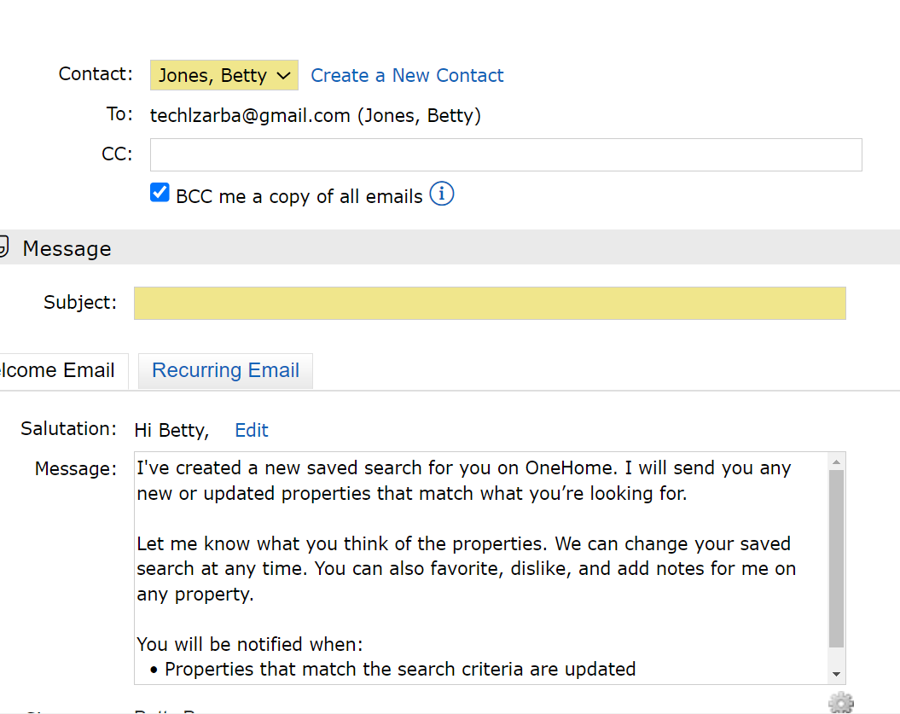
Saved Search to Auto Email

Slide 12
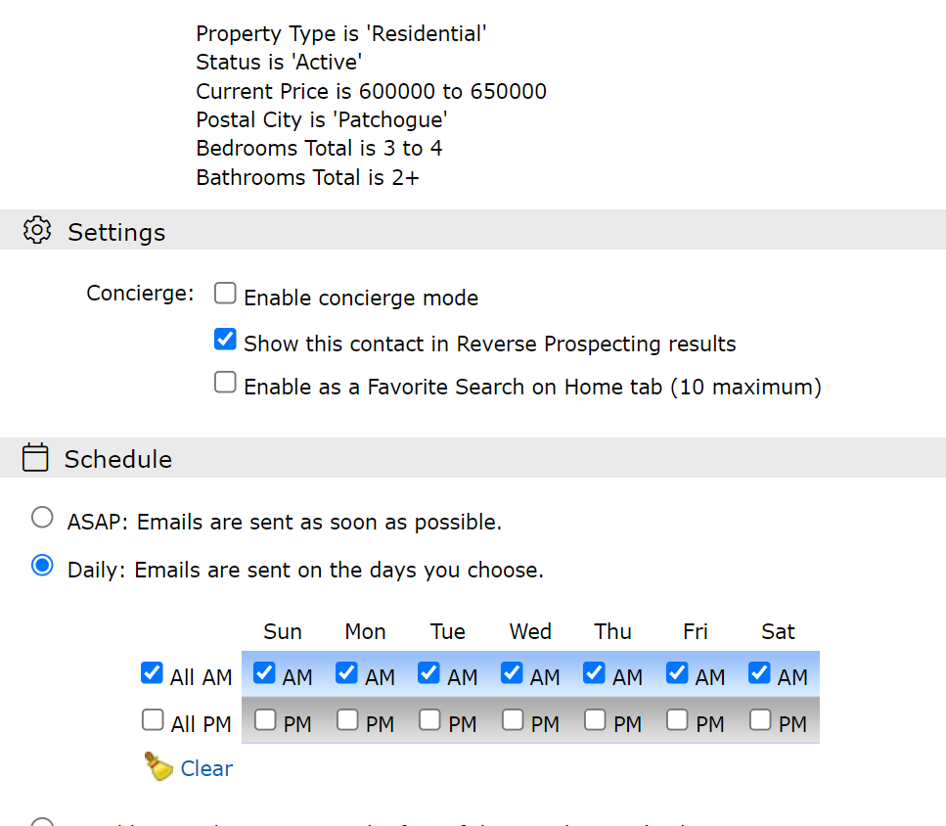

Slide 13
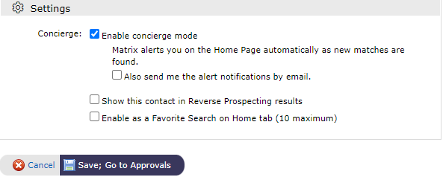
Auto Email: Concierge Mode

Slide 14
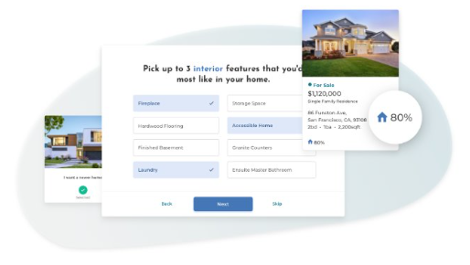
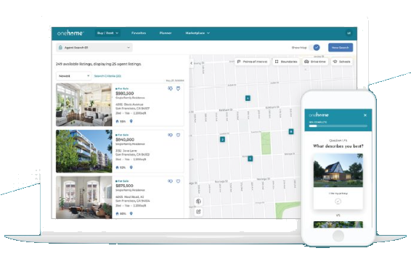
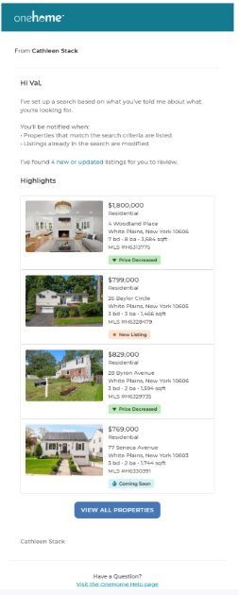
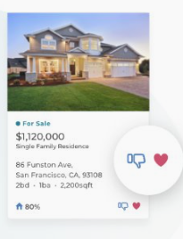
Client Experience

Slide 15
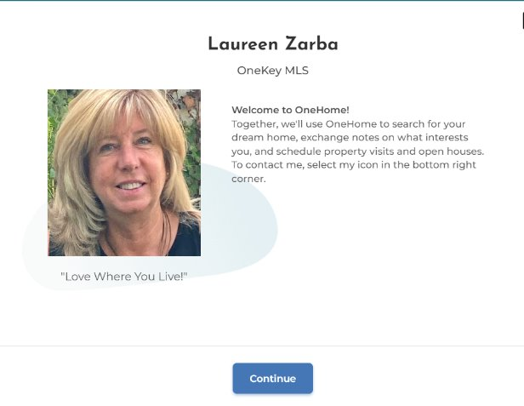

Slide 16
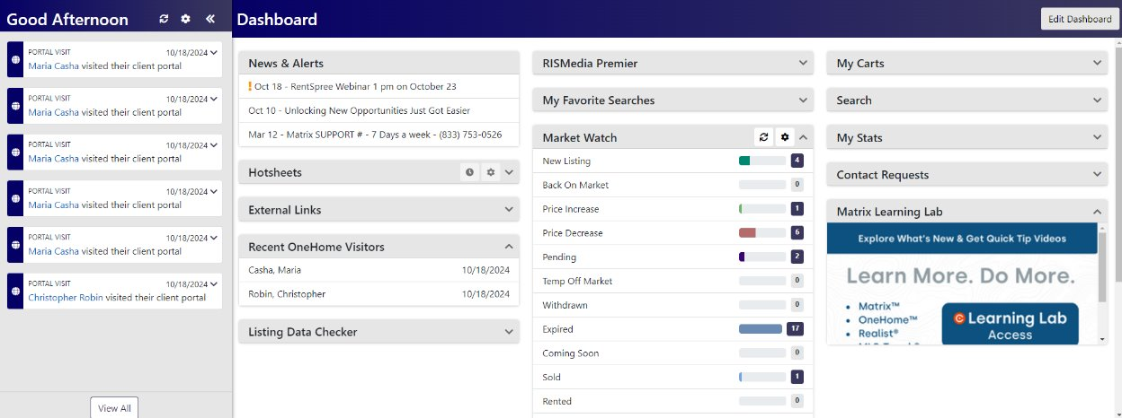
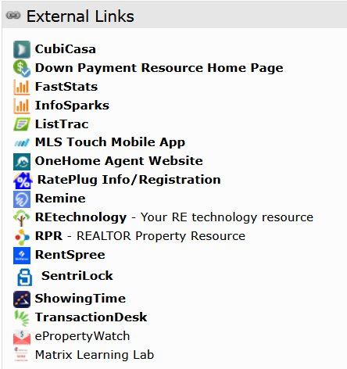
Agent Experience: Dashboard Client Activity

Slide 17
Agent Experience: Contacts
Client Activity

Slide 18
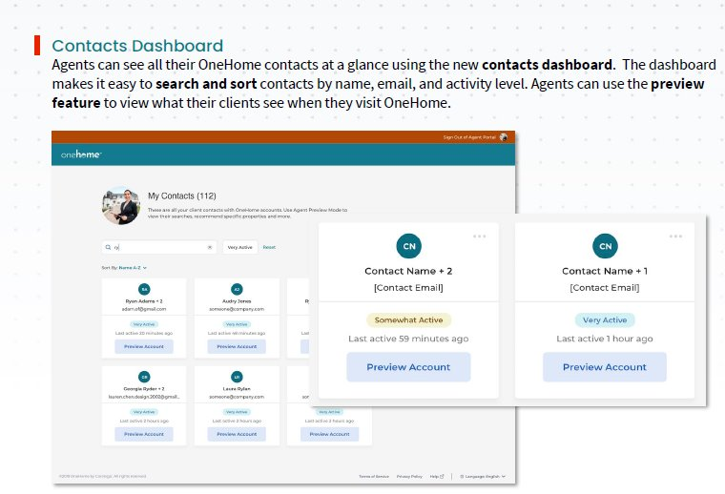
Agent Experience: Agent Portal

Slide 19
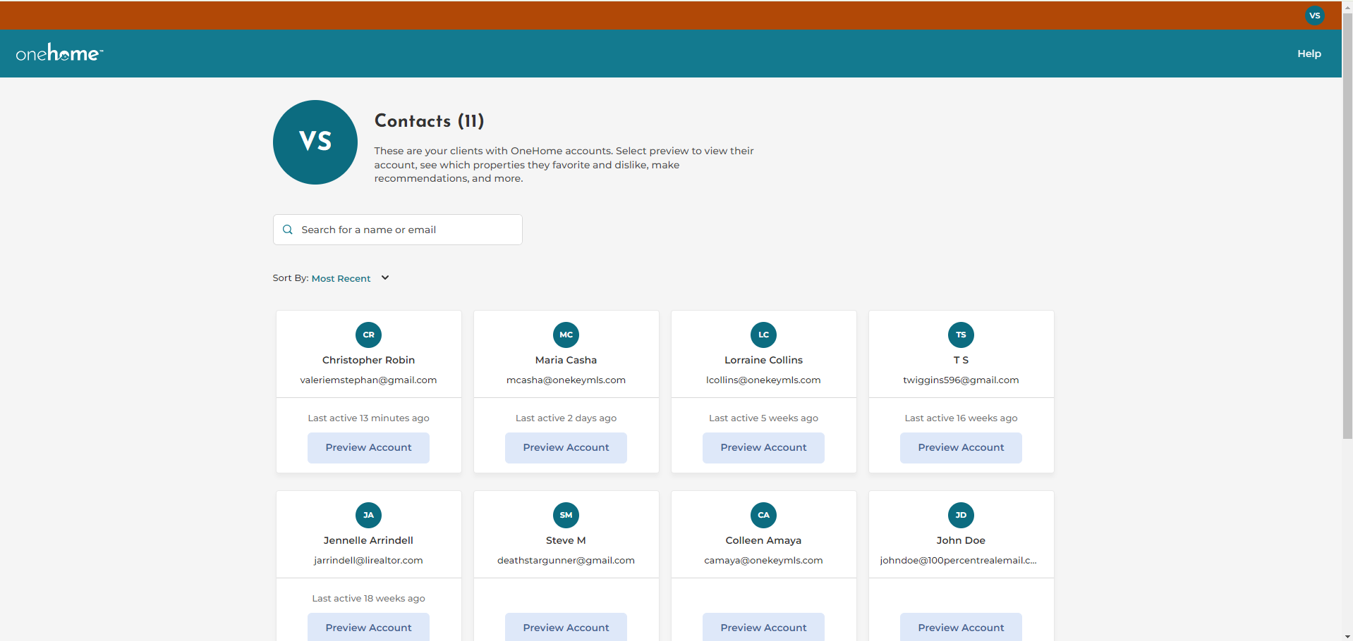
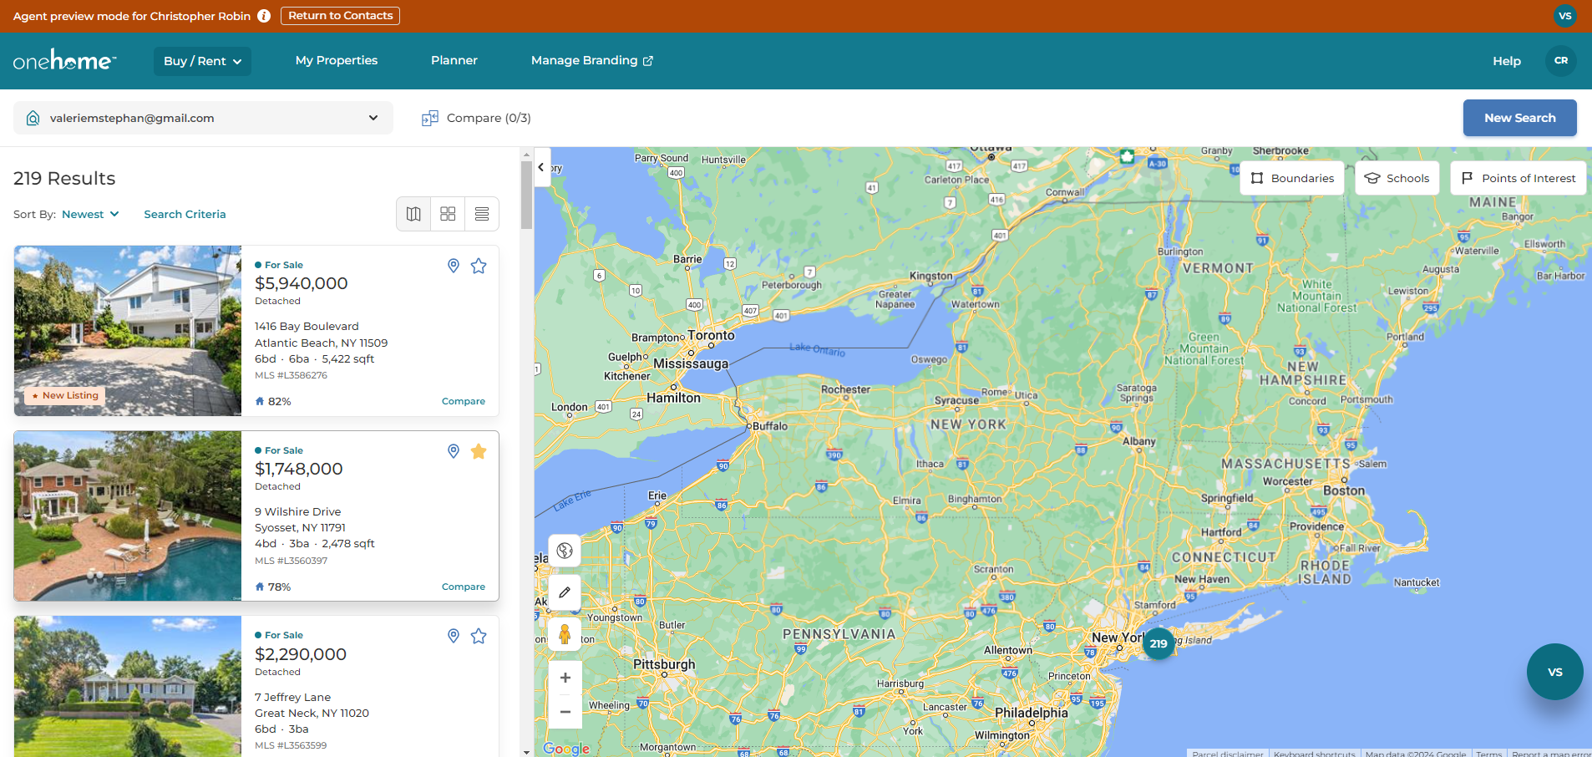
Agent Experience

Slide 20
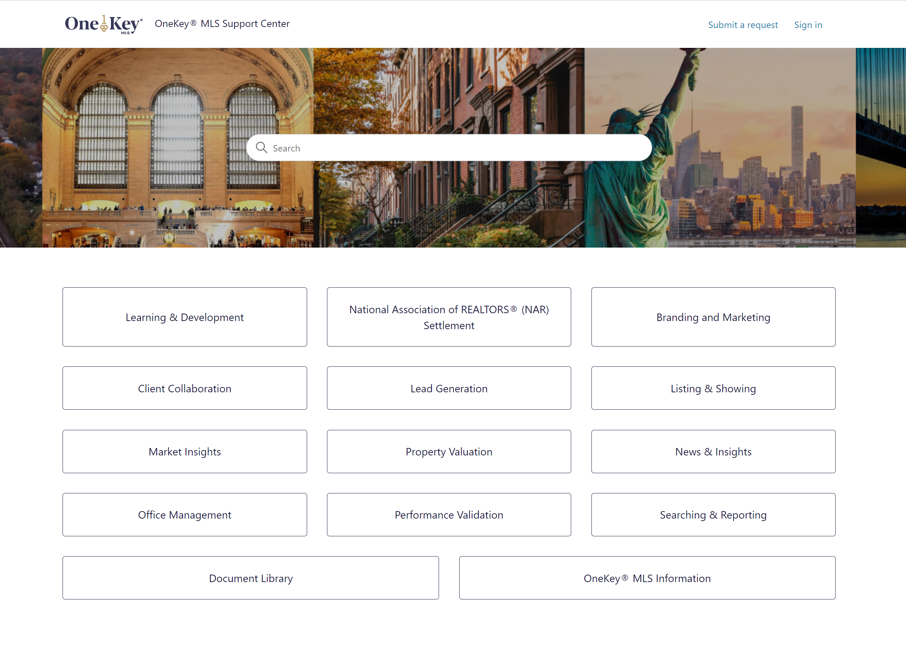
Support.OneKeyMLS.com

Slide 21
Prepare
Nov 5-18
Questions?

