Slide 1
Searching and Reporting
Stratus-to-Matrix
Train-the-Trainer
Notes:
Welcome to your new OneKey MLS experience! As you get started we want to make sure you are prepped and ready to hit the ground running the day you cutover fully to using your new central dashboard provided by Clareity, Matrix, Realist, OneHome and an enhanced MLS-Touch. With that in mind, we’ve divided your onboarding into 3 phases, with clear actions and information for each step of your progression:

Slide 2
Corporate.OneKeyMLS.com/Stratus-to-Matrix

Slide 3
Agenda
Quick Dashboard Search
Property Type Search
Criteria
Map
Results
Action Bar

Slide 4
Quick Search

Slide 5
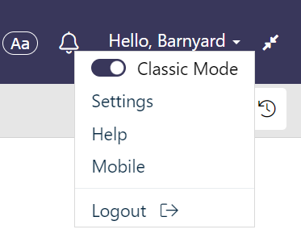
Classic vs New Mode

Slide 6
Search Main Menu

Slide 7
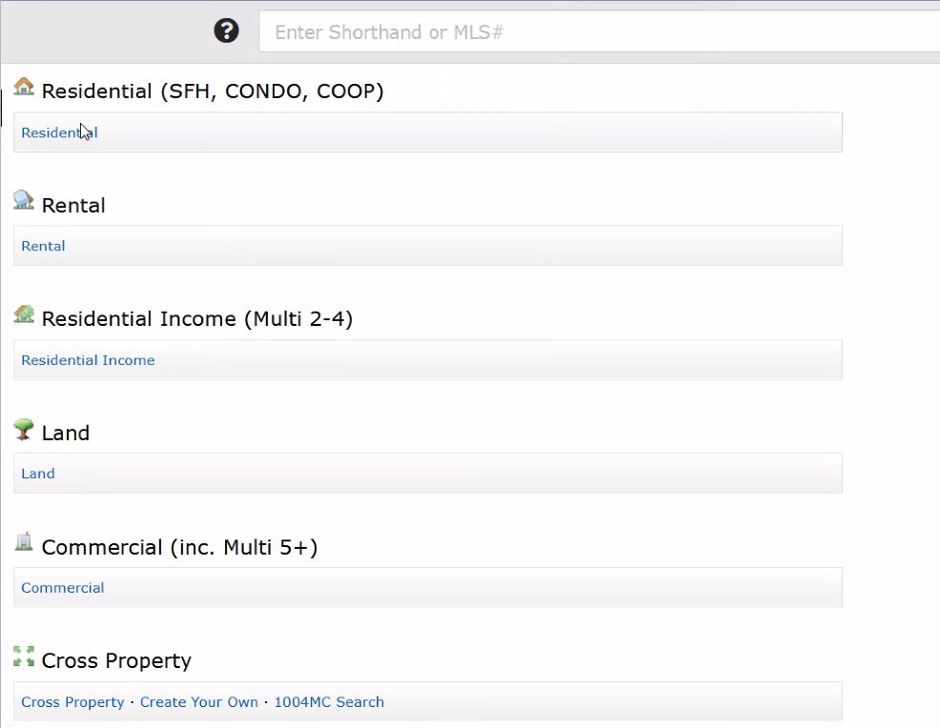
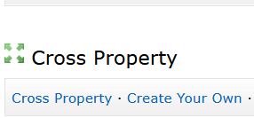
Property Type Searches

Slide 8
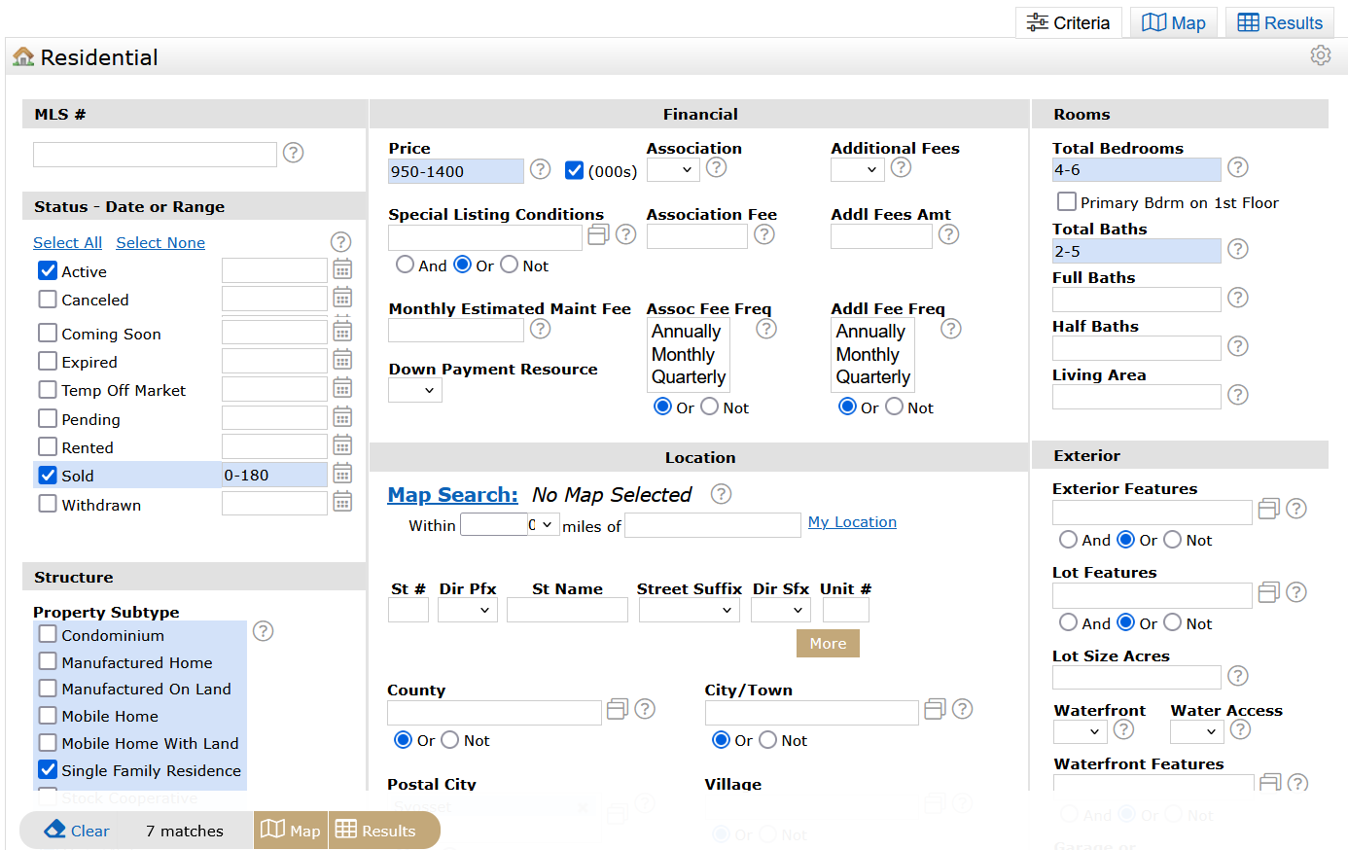
Search Criteria

Slide 9
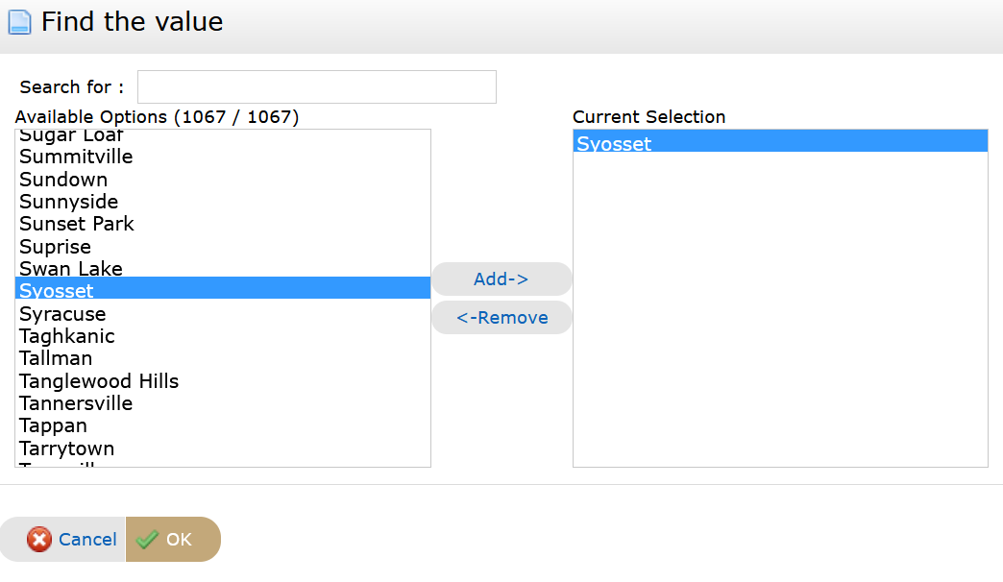
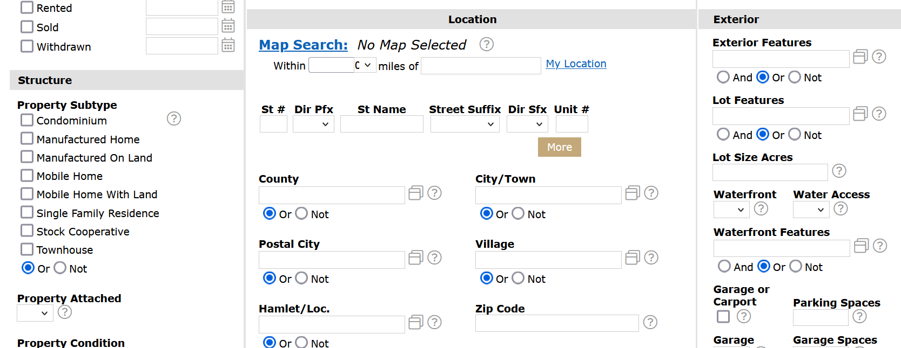
Location

Slide 10
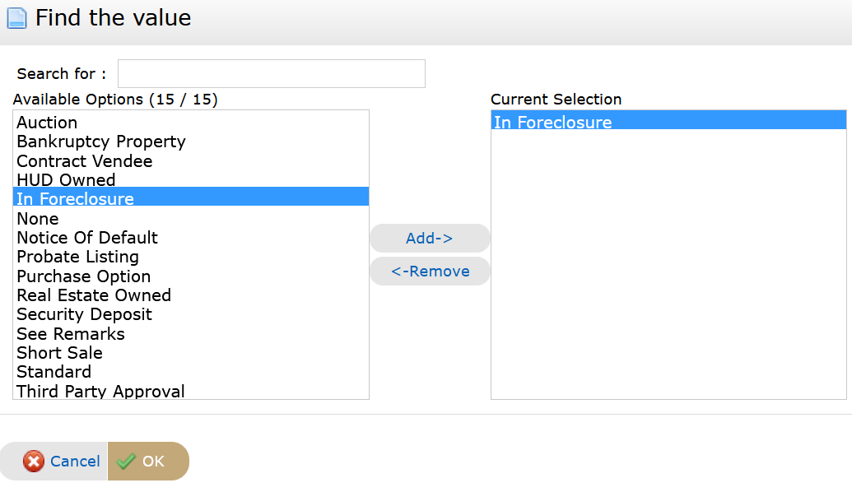
Special Conditions

Slide 11
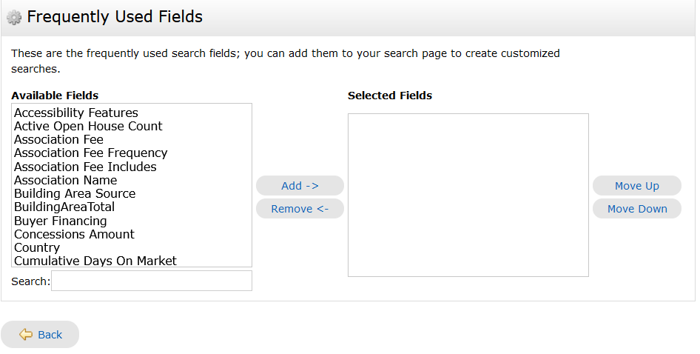
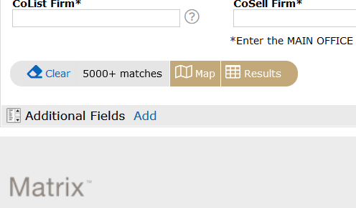
Adding Additional Fields

Slide 12
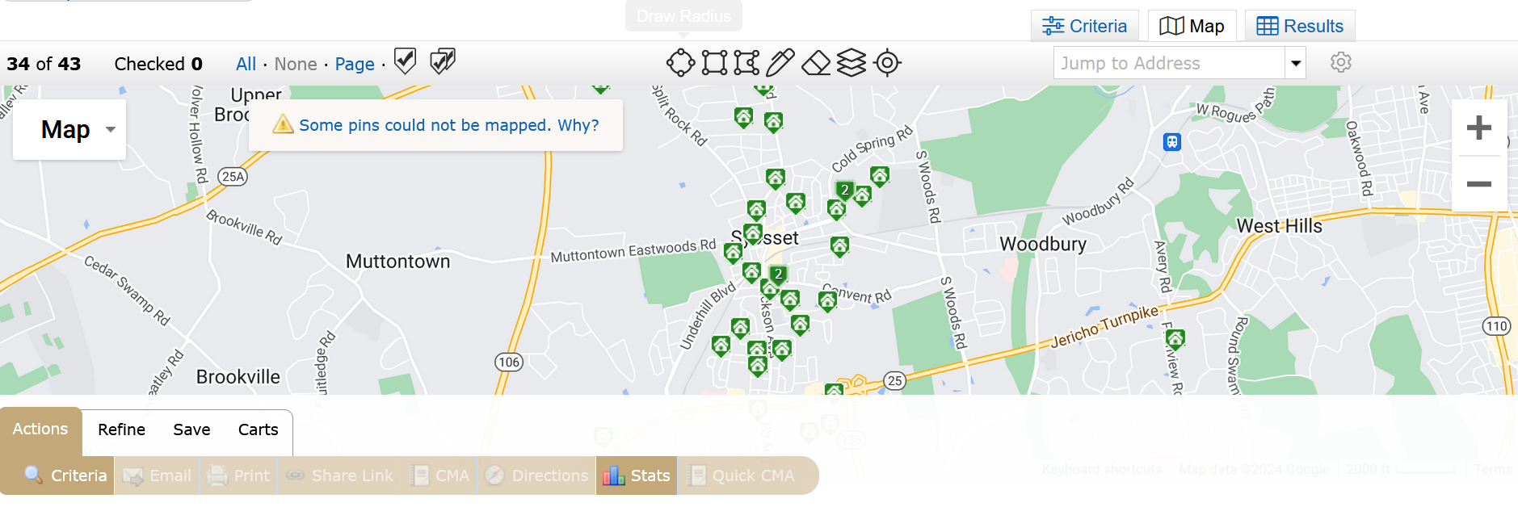
Map

Slide 13
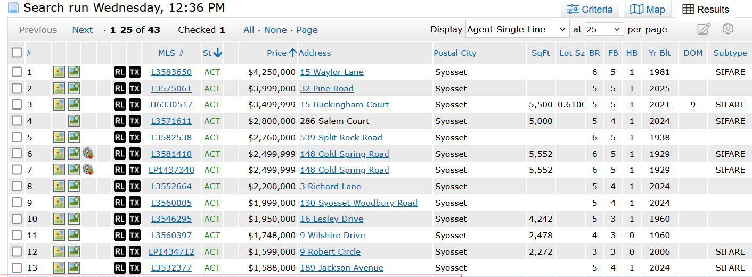
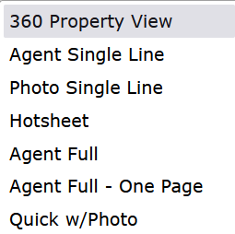
Results

Slide 14
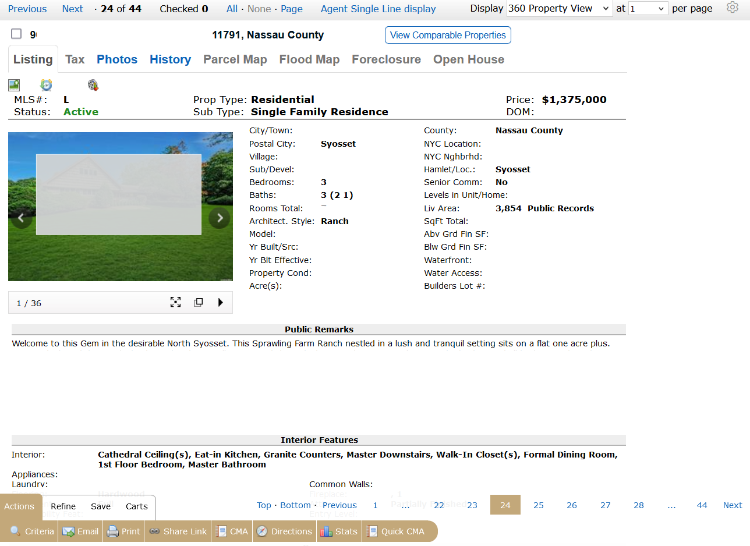
360 Display

Slide 15
Actions Bar

Slide 16
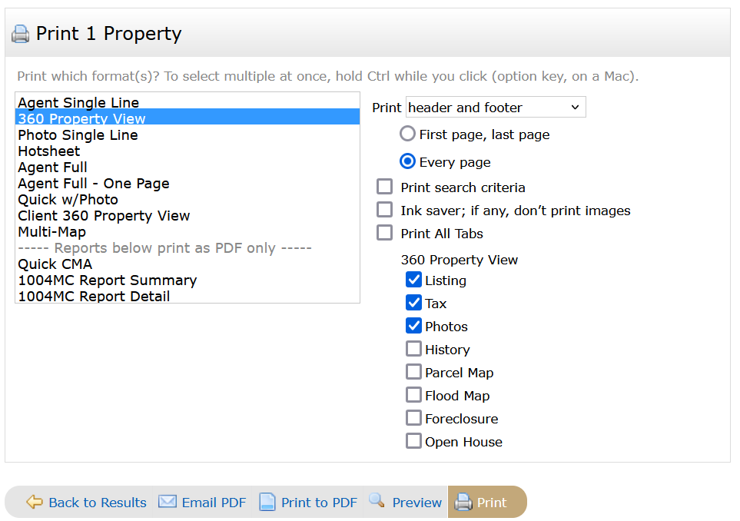
Actions Bar - Print

Slide 17
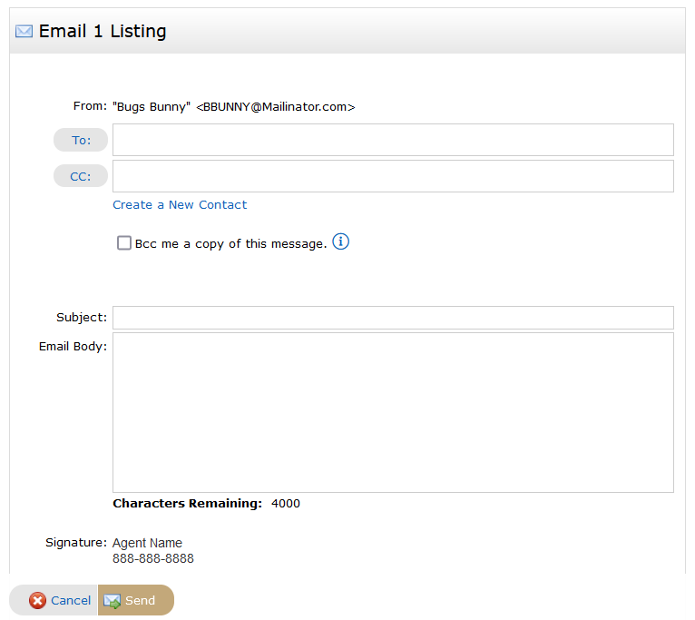
Actions Bar - Email

Slide 18
Additional Bars

Slide 19
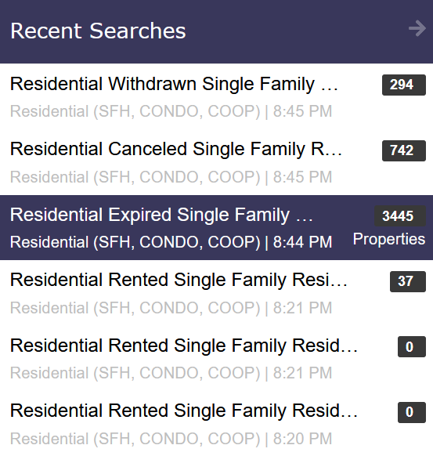
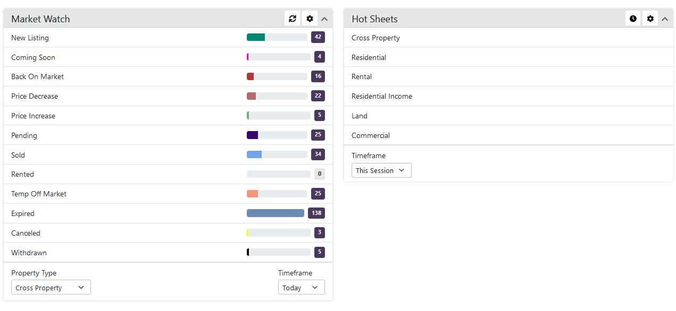
Additional Searches

Slide 20
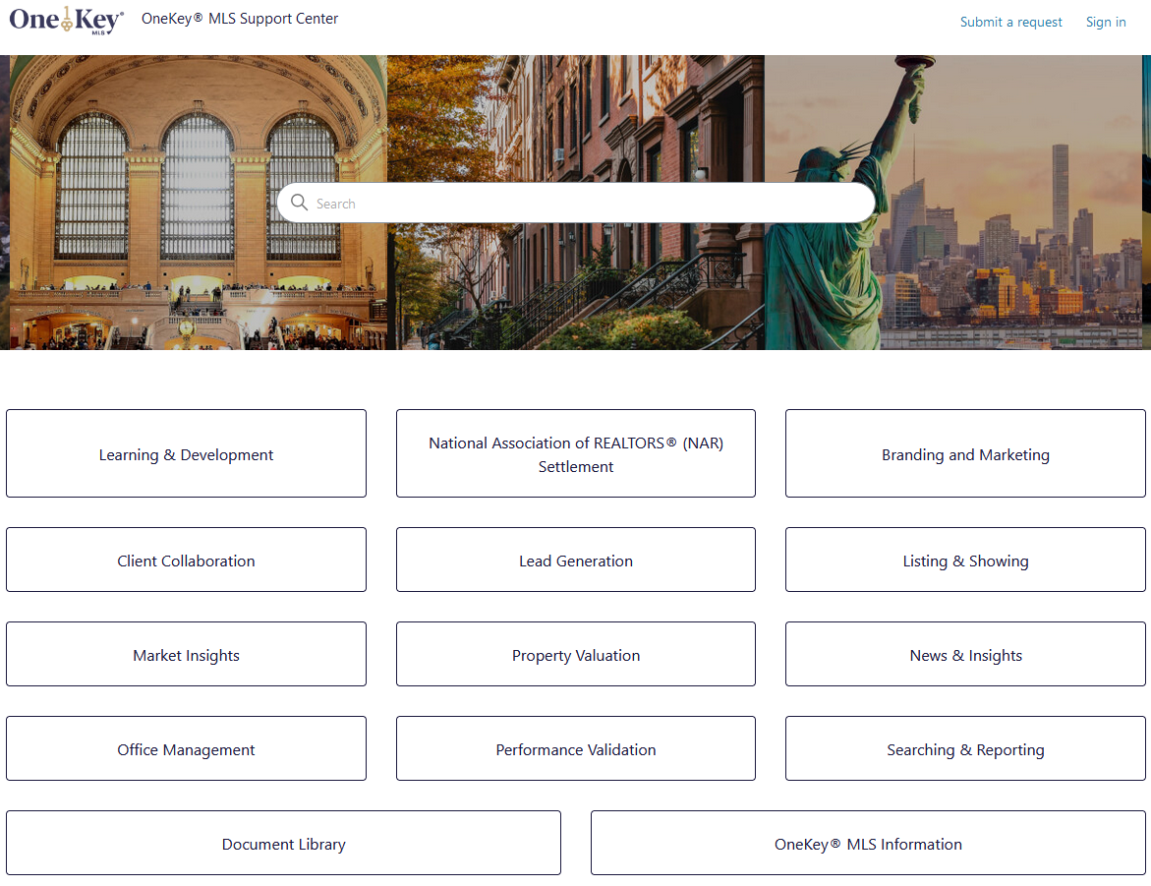
Support.OneKeyMLS.com

Slide 21
Prepare
Questions?

