Slide 1
Getting Started
Stratus to Matrix Onboarding
Notes:
Welcome to your new OneKey MLS experience! As you get started we want to make sure you are prepped and ready to hit the ground running the day you cutover fully to using your new central dashboard provided by Clareity, Matrix, Realist, OneHome and an enhanced MLS-Touch. With that in mind, we’ve divided your onboarding into 3 phases, with clear actions and information for each step of your progression:

Slide 2
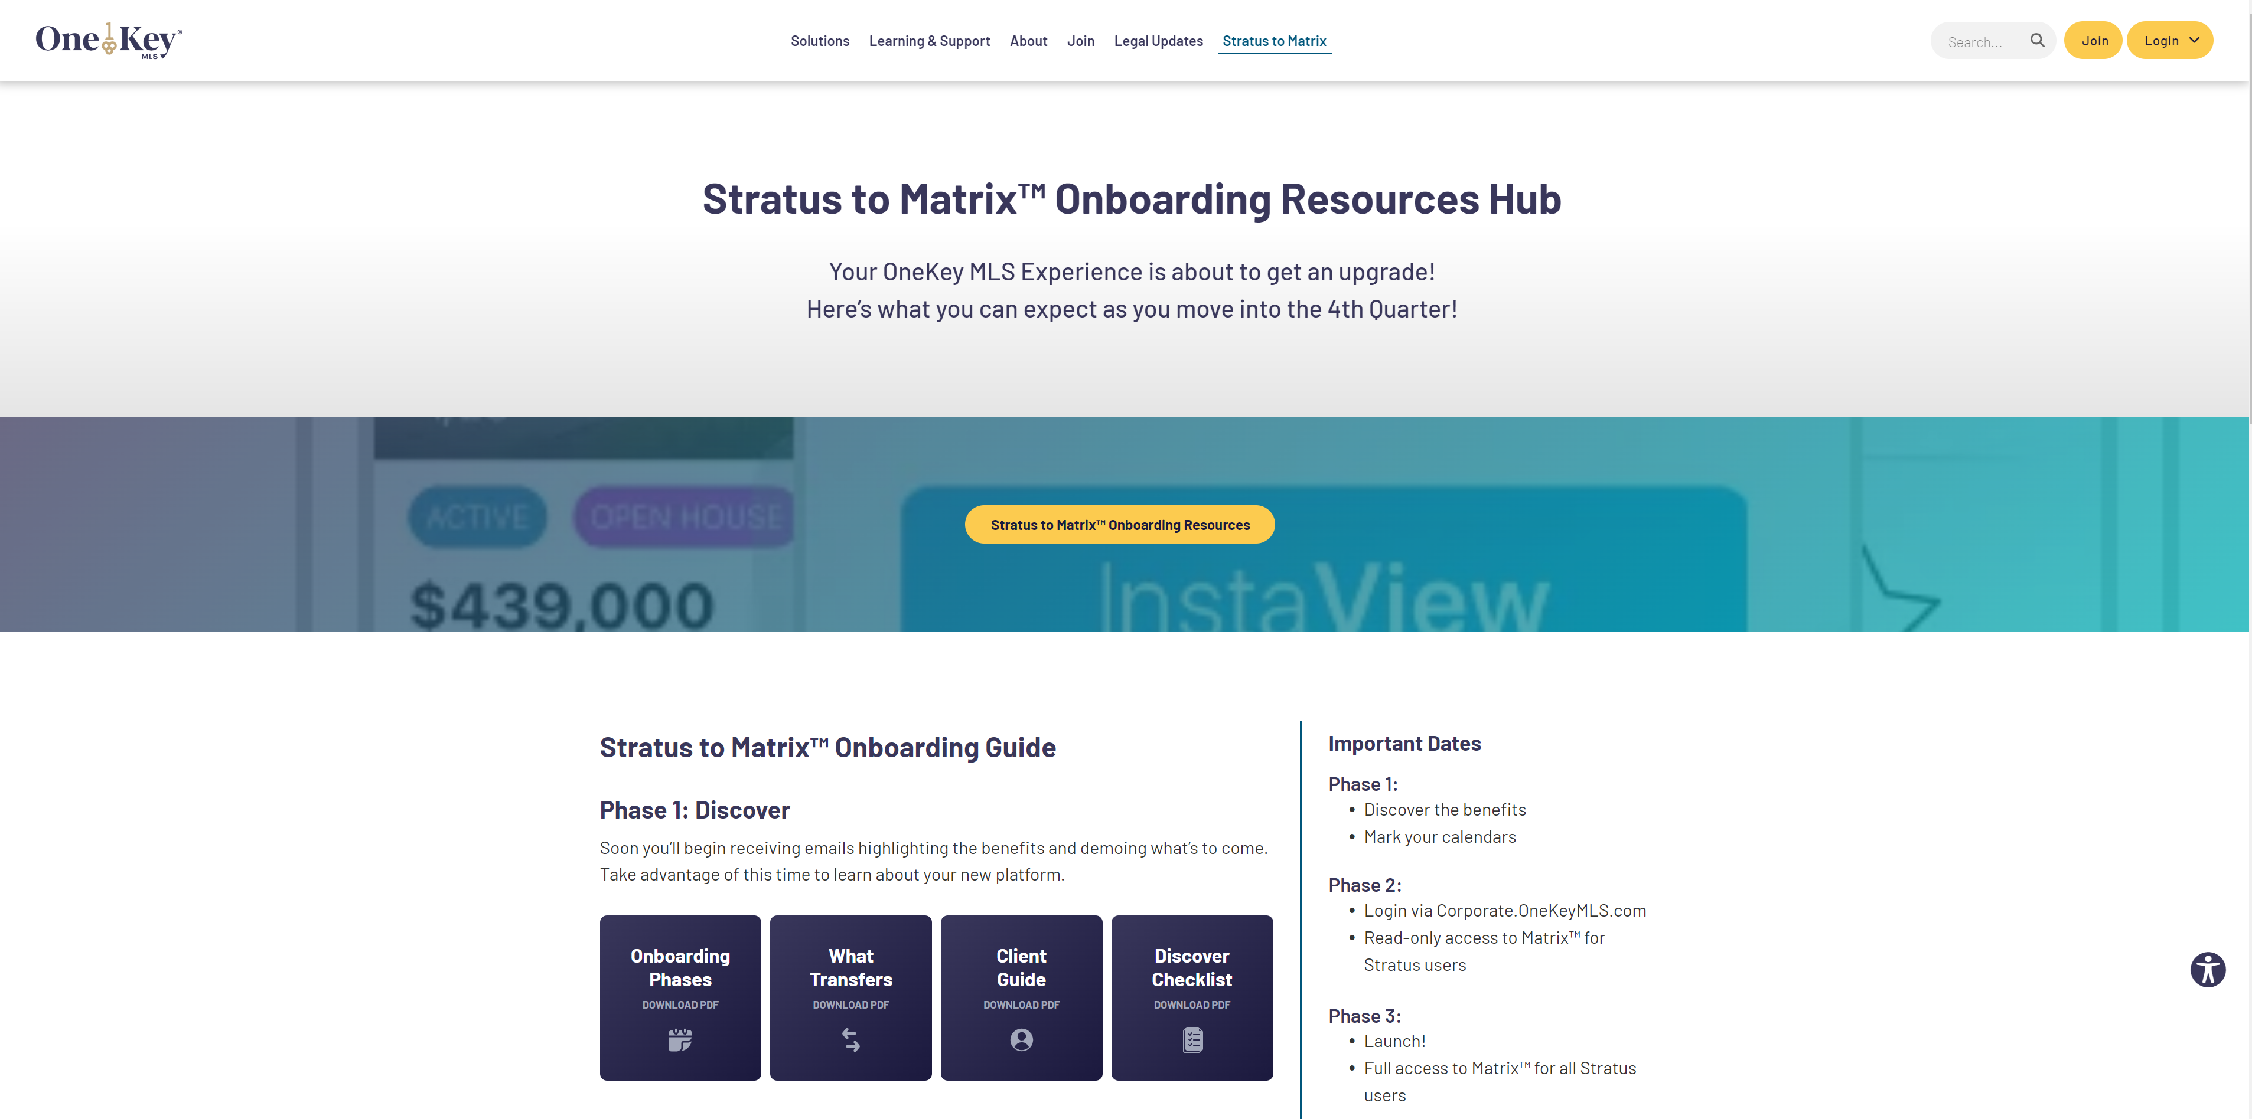
Corporate.OneKeyMLS.com/Stratus-to-Matrix

Slide 3
3 Phases
to make way for a new way!
Prepare
Nov 18-Dec 2
Launch
Dec 3
Discover
Now

Slide 4
Phase 1 Checklist
Discover
Now
Confirm your contact info is correct with your association
Do a little housekeeping
Backup your records
Mark your calendar: Nov 18 - Dec 2, Dec 2 - 3
Keep an eye on your email
Prep your clients
Bookmark the resource page:
Corporate.OneKeyMLS.com/Stratus-to-Matrix

Slide 5
Phase 2 Checklist
Prepare
Nov 18 – Dec 2
Set up multi-factor authentication and log in
Set up your branding & preferences
View your listings
Compare your contacts, add yourself as a contact
Search for listings
Create an auto email with yourself as the recipient. Explore OneHome.
Convert your Saved Searches into Auto Email
Take advantage of learning & development
Brokers: Check your roster
Brokers: Check your office logo and contact information

Slide 6
Phase 3 Checklist
Launch
Dec 3
Update Saved Searches to Auto Email (if not done so already)
Finish any unfinished checklists
Create an incomplete listing.
Uninstall Collab and install MLS-Touch
Take advantage of advanced learning & development (Advanced searching, CMAs, Realist public records, etc).
Bookmark Support.OneKeyMLS.com

Slide 7
Agenda
MFA & Login
Tour
Main Menu
Market Insights
Branding
Dashboard

Slide 8
Multi-Factor Authentication (MFA)

Slide 9
Multi-Factor Authentication

Slide 10
Corporate.OneKeyMLS.com

Slide 11
Clareity Tour
Three Versions:
LIBOR
HGAR
Staff
User Customizable Widgets:
My Personal Links
My Favorite Apps
Admin Customizable Widgets
OneKey News &Updates
OneKey Calendar

Slide 12
Matrix Main Menu

Slide 13
Matrix Main Menu

Slide 14
Matrix Main Menu

Slide 15
Matrix Main Menu

Slide 16
Matrix Main Menu

Slide 17
Matrix Main Menu

Slide 18
Matrix Main Menu

Slide 19
Matrix Main Menu

Slide 20
Matrix Main Menu

Slide 21
Matrix Main Menu (Agent)

Slide 22
Matrix Main Menu (Broker)

Slide 23
Branding
Agent Photo, Office Logo, and Account Information transfer automatically.

Slide 24
Branding
Agent Photo, Office Logo, and Account Information transfer automatically.

Slide 25
Branding

Slide 26
Matrix Dashboard

Slide 27
Matrix Dashboard

Slide 28
Market Insights: Market Watch

Slide 29
Market Insights: Hot Sheets

Slide 30
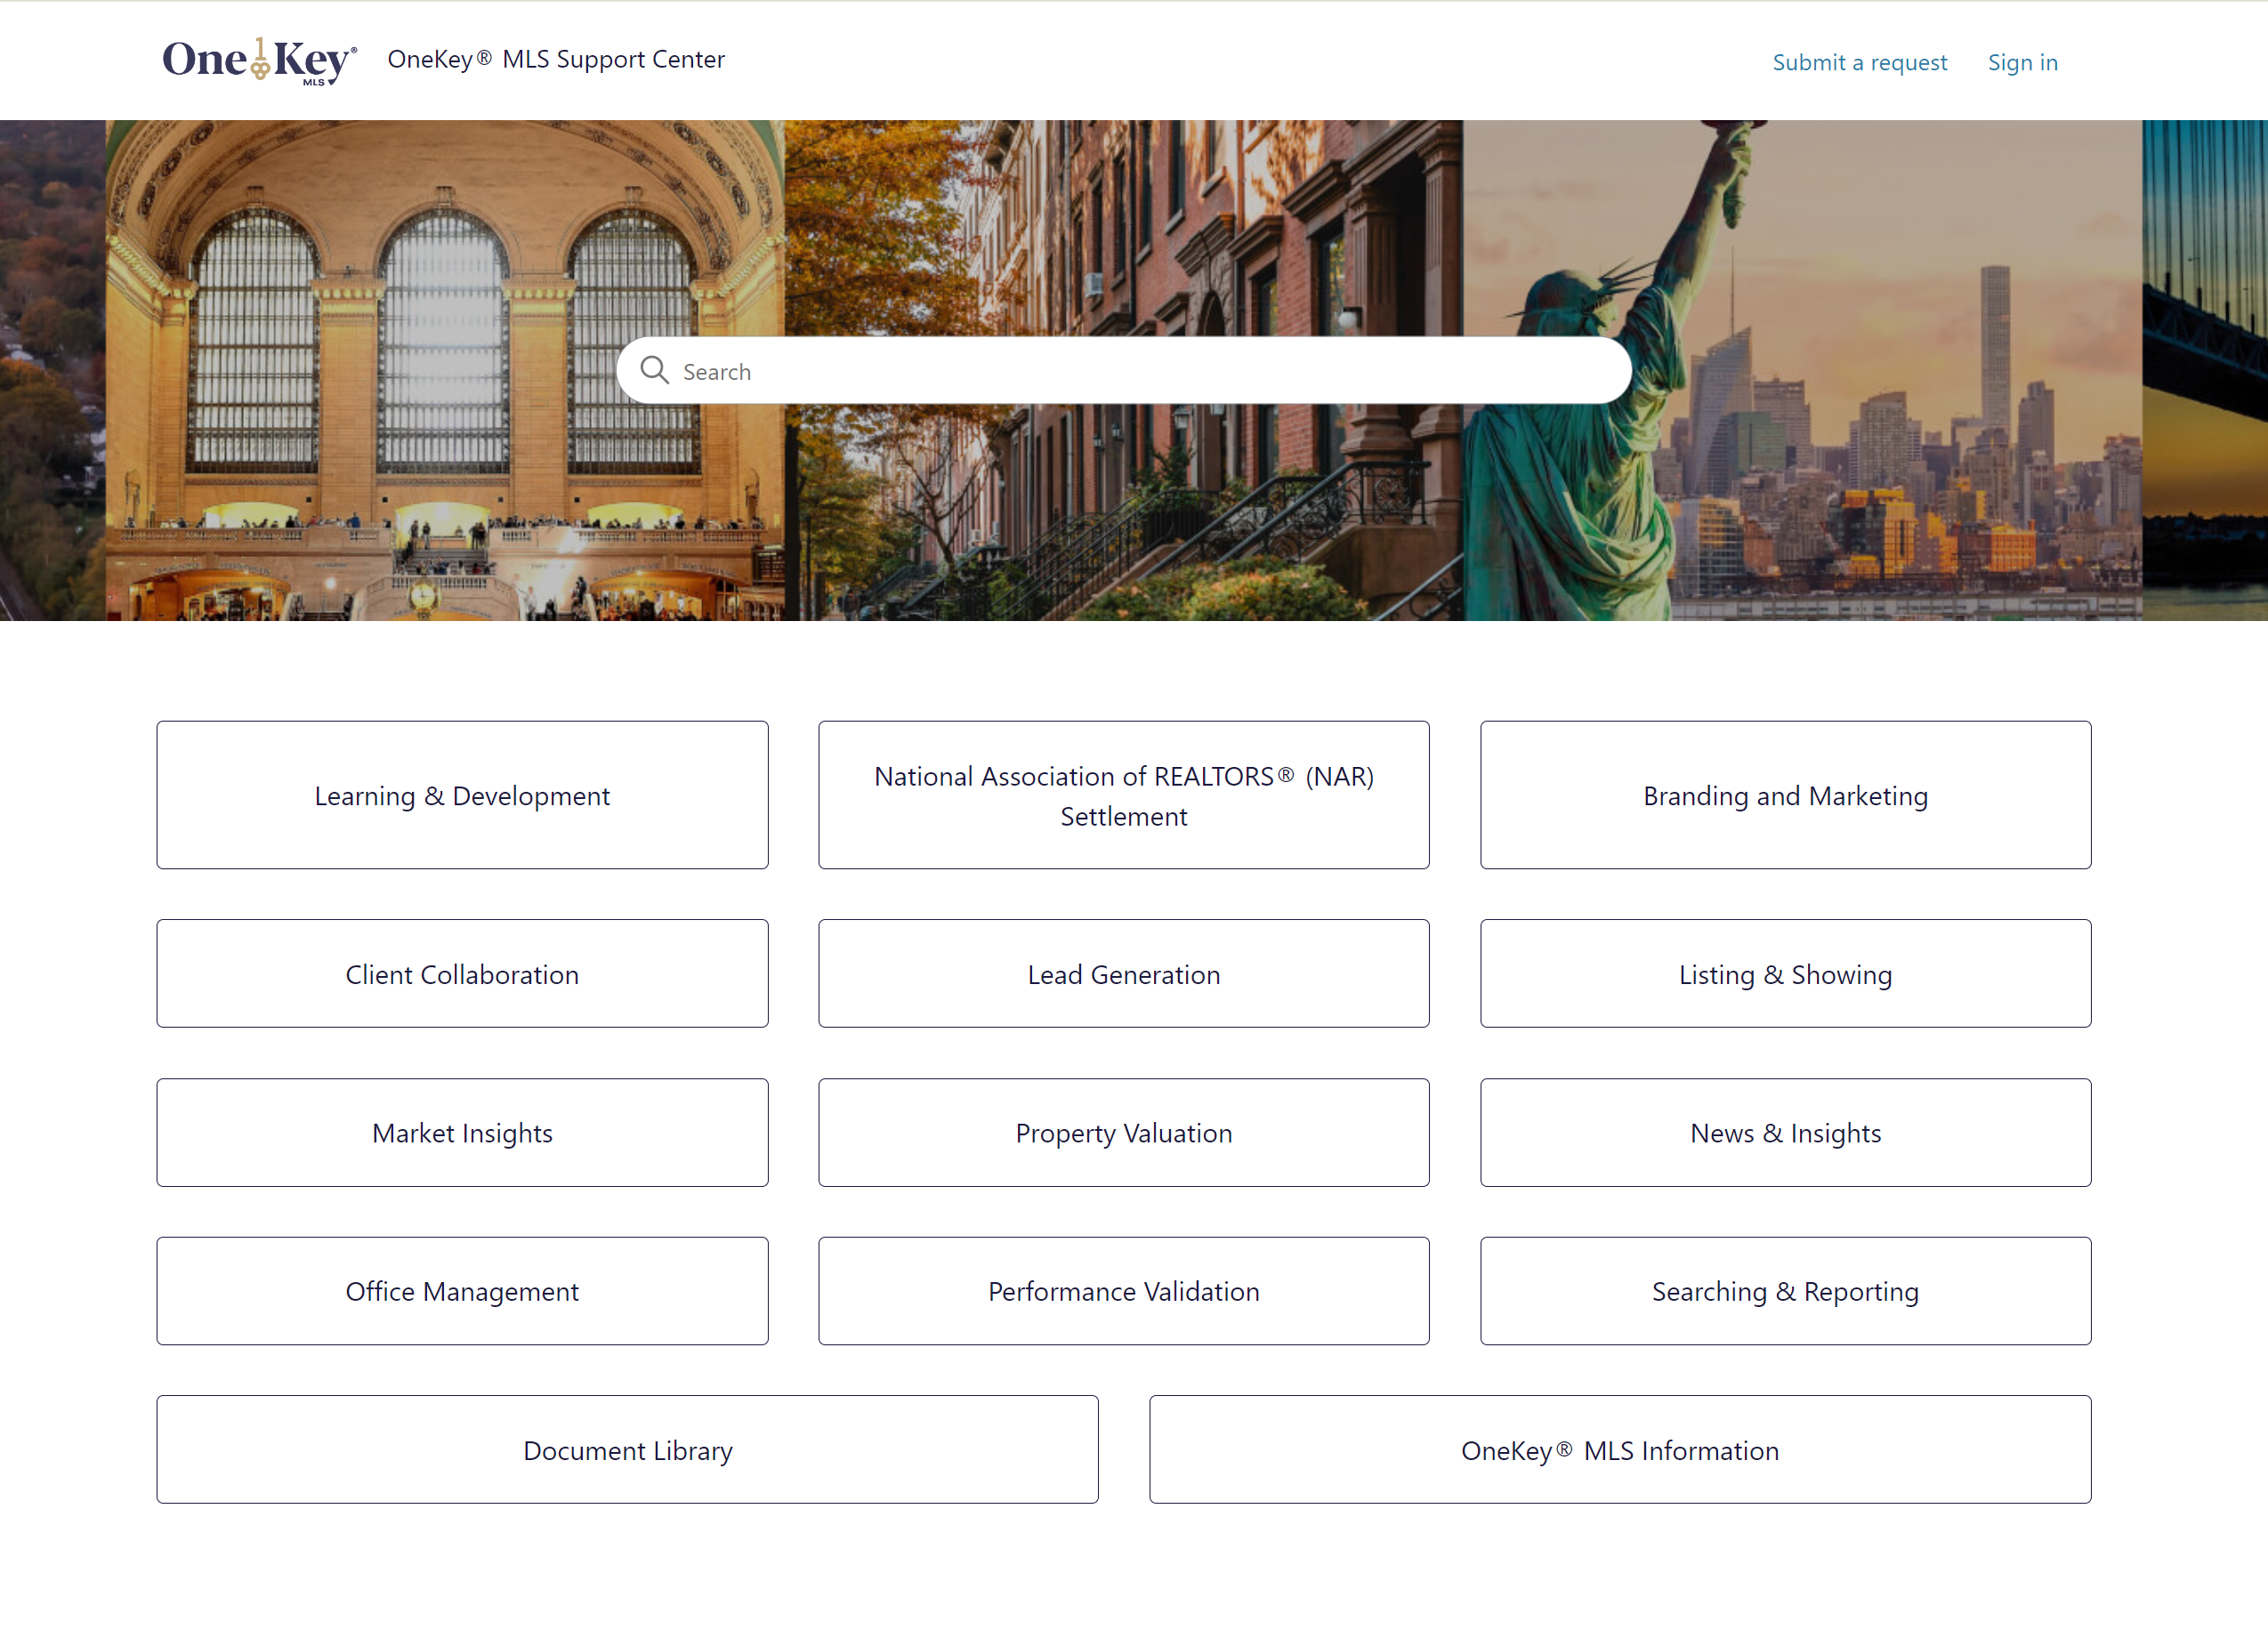
Support.OneKeyMLS.com

Slide 31
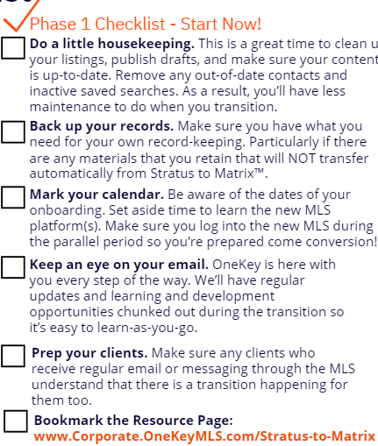
Til Next Time

Slide 32
Prepare
Nov 5-18
Questions?

